Slide 1
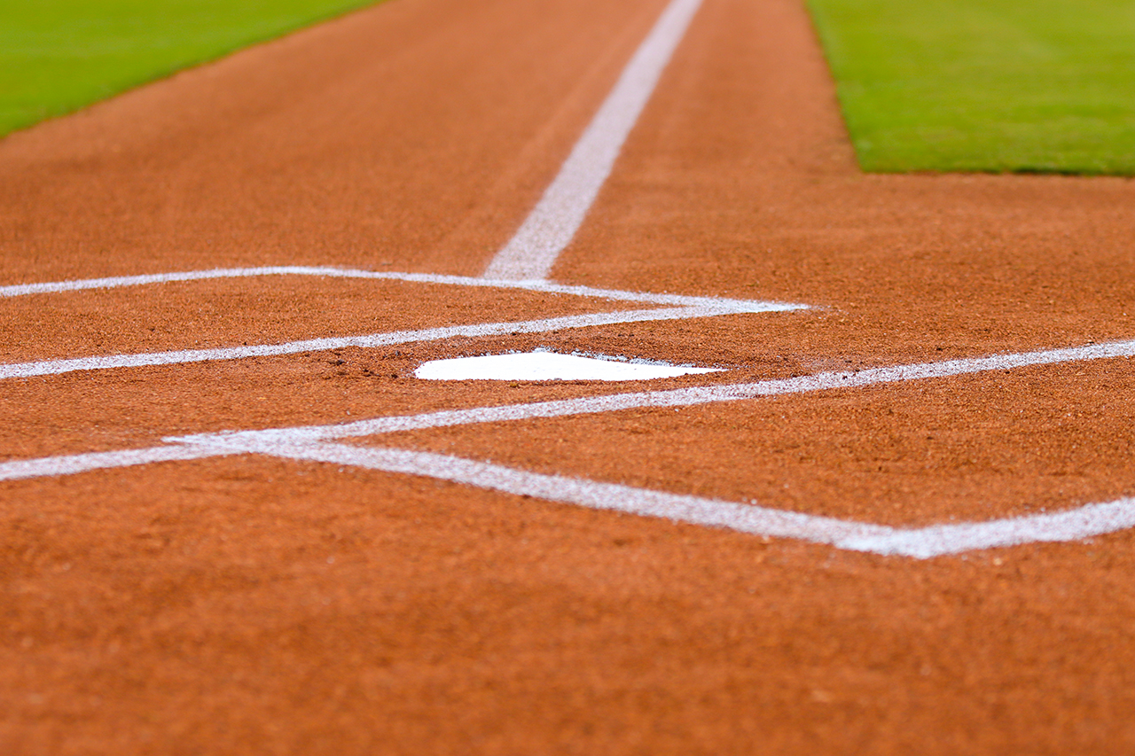
Baseball and Soccer Fields
If We Build It
They Will Come
Park Facility Use and Fees. What possibilities can we imagine

Slide 2
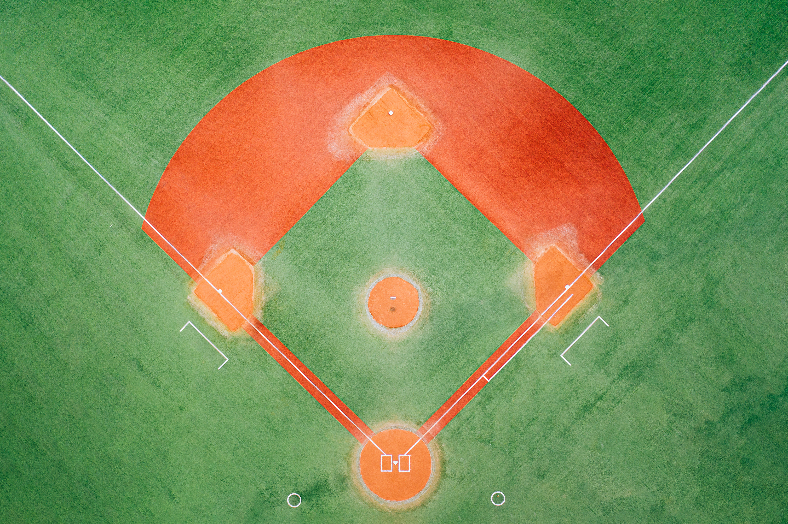
High School
Little League and Softball Fields

Slide 3
Our fields today
Jack Rowe Field
Used for JV Practice and Little League practice and games

Slide 4
John Pock Field
Used by Little League for practice and games.

Slide 5
Jo Robbins Field
Used for Little League Ball Practice and Games.

Slide 6
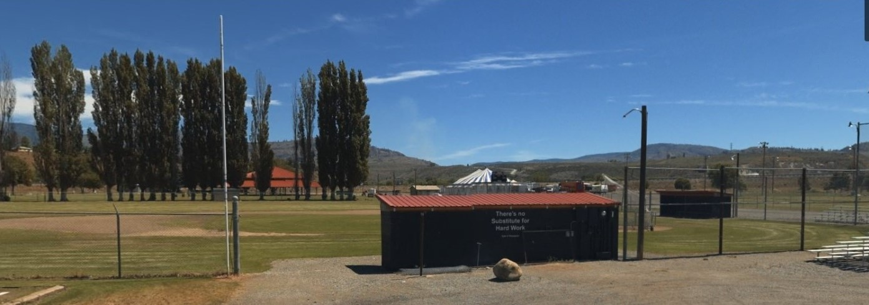
Ross McCormick Field
Used by Varsity and JV Games, Little League Practice and Games.

Slide 7
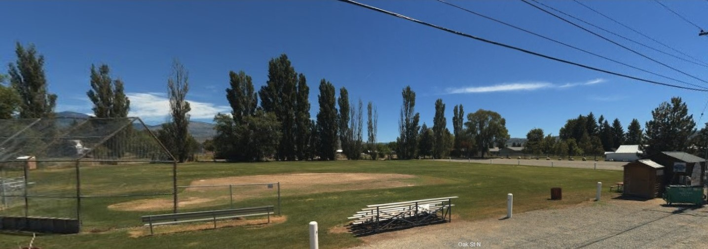
Oak Street Field
Used by O&O and New Softball Leagues for Practice and games, and Little League Practice.

Slide 8
Shirley Bowden Field
Used by High School Varsity and JV for Practice and Games, O&O and New Softball Games and Little League Practice.

Slide 9
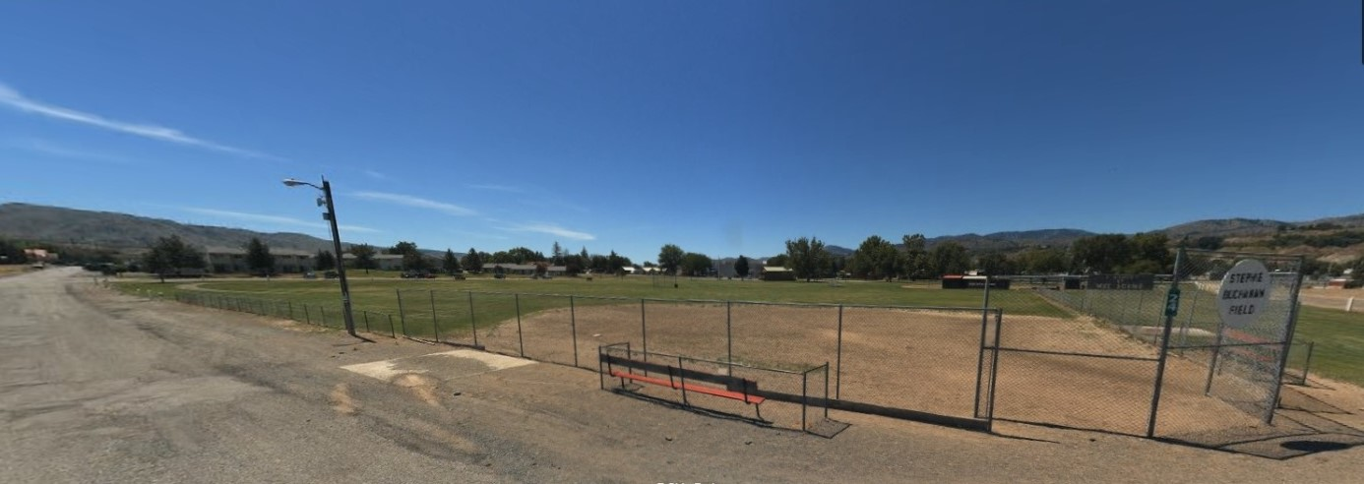
Used by Little League for Practice, O&O and New Softball Leagues for Games. The Field is not in good shape making it hard to play on.
Stephi Buchanan Field

Slide 10
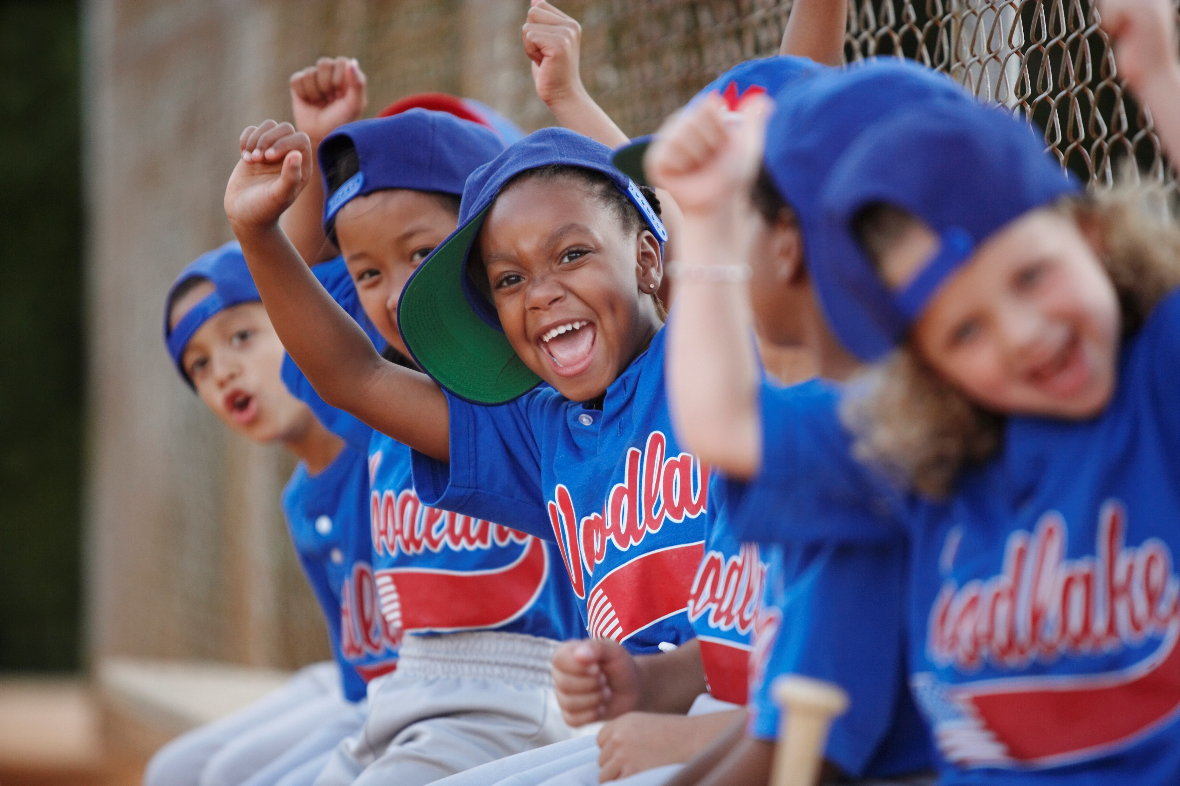
Their Fields

Slide 11
Chelan Ball Fields
Fields are in good condition with lights, Bathrooms, Concessions, and good Fencing designed for Baseball.

Slide 12
Eastmont Parks
4-Plex made for baseball. High backstops, large seating sections, Lights, Warning Tracks, Padded fences for safety, Foul Poles, Large storage and concession area. Great for tournaments and playoff games.

Slide 13
Okanogan Valley Sports Complex
4-plex with fencing designed for Baseball and Softball, padded outfield fences for safety, well maintained fields that attract Tournaments, Leagues and events

Slide 14
Wenatchee Youth Baseball Fields
Well maintained ball fields designed for Little League use. Baseball style fencing with padded outfield fences for safety, large concession storage building, lighted fields. Attractive design attracts tournaments leagues and events.

Slide 15
Ball Fields that would be comparable to ours in condition designed for a much smaller community
Tonasket Ball Fields

Slide 16
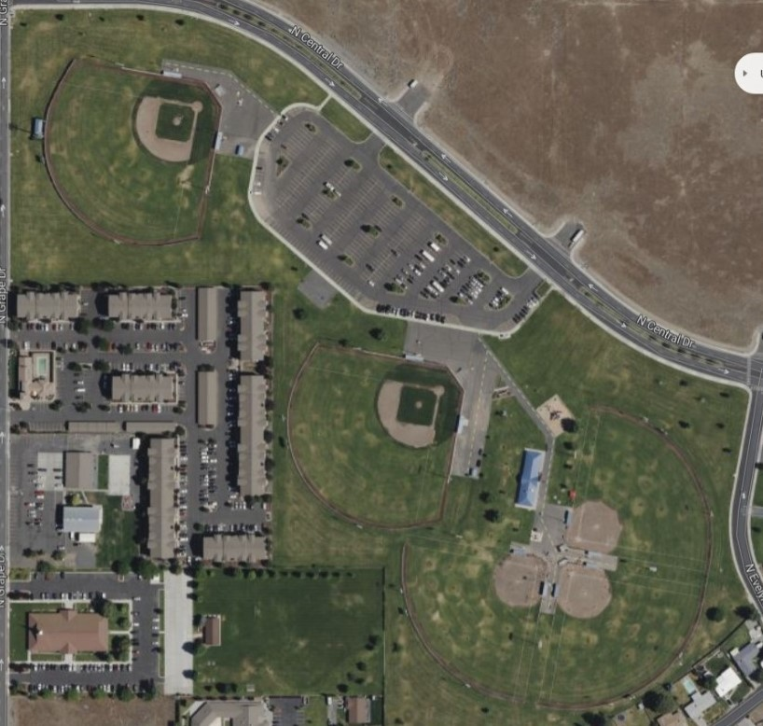
Moses Lake Fields
The Paul Lauzier Athletic Complex has Softball, Baseball, Basketball, and soccer available. The Ball fields are lighted and have Baseball Style fencing. Well maintained and groomed fields.

Slide 17
Soccer Fields

Slide 18
Omak New Soccer Fields
Used by High School Varsity, River Valley and NCW Youth Soccer Leagues U14.

Slide 19
Used by River Valley and NCW Youth soccer Leagues. Three total fields for practice and games
Omak Pavillion
Soccer Fields

Slide 20
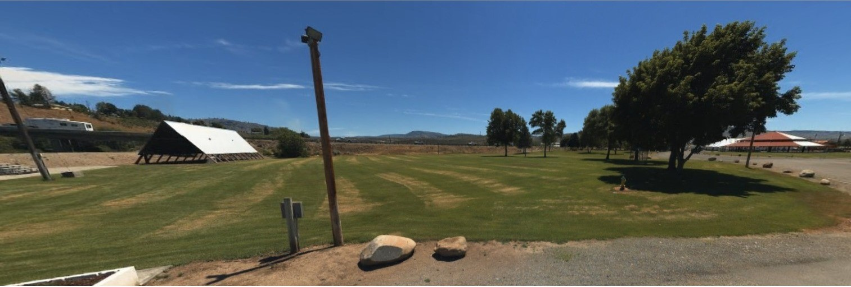
Omak RV
Soccer Field
Used by River Valley and NCW Youth soccer Leagues for practice and games. Usually, four are fields set up in this area.

Slide 21
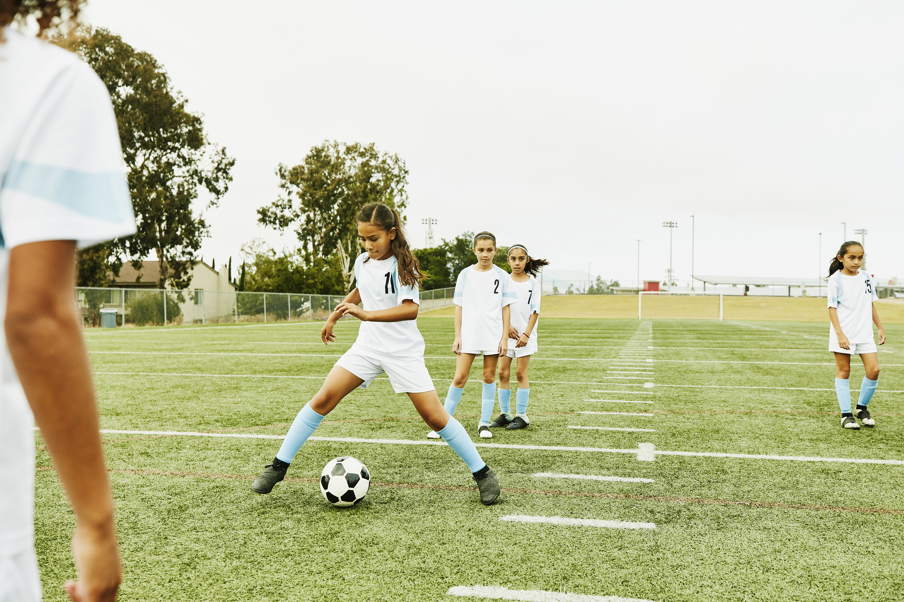
Their Fields

Slide 22
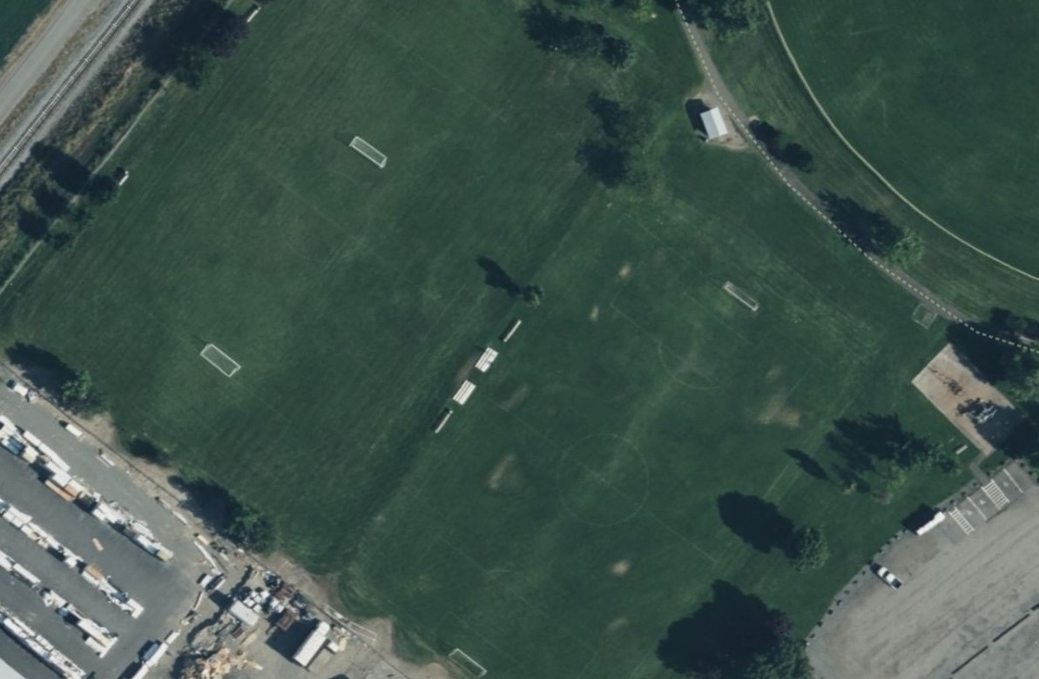
Okanogan
Soccer Fields
Located in the Sports Complex

Slide 23
Tonasket
Soccer Fields
Several Fields Large and Small set up for games and practice.

Slide 24
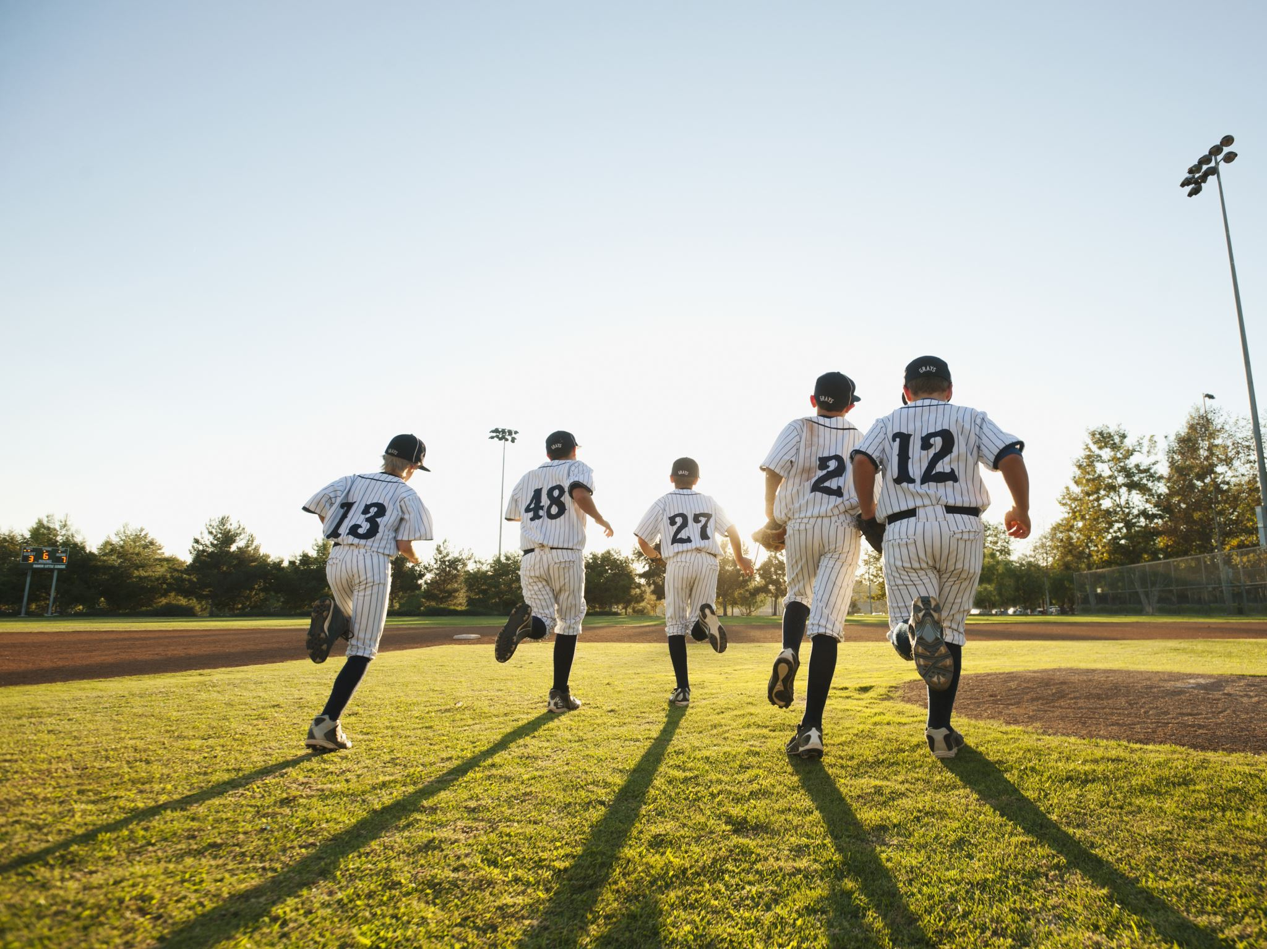
Omak is the only Municipality in North Central Washington that has a park with sports facilities, that does NOT charge fees to use those facilities.
Other Municipalities that have Park Shelters, Tennis Courts, Pickleball Courts, or Sports fields have fees associated with them to help offset the costs of maintaining them.

Slide 25
Most communities in North Central Washington have School Districts with sporting facilities that the Public or Youth Leagues can use. The Parks do not have the fields. Omak does not have that option because the High School uses Eastside Park for 4 of their Varsity Sports. Baseball, Soccer, Tennis, and Cross Country.

Slide 26
The annual cost for three of the tasks associated with maintaining the Parks for 2024 was almost $56,000.00. Mowing, Cleaning Bathrooms, and Applying Herbicides. This is just for Eastside and Oak St Parks.

Slide 27
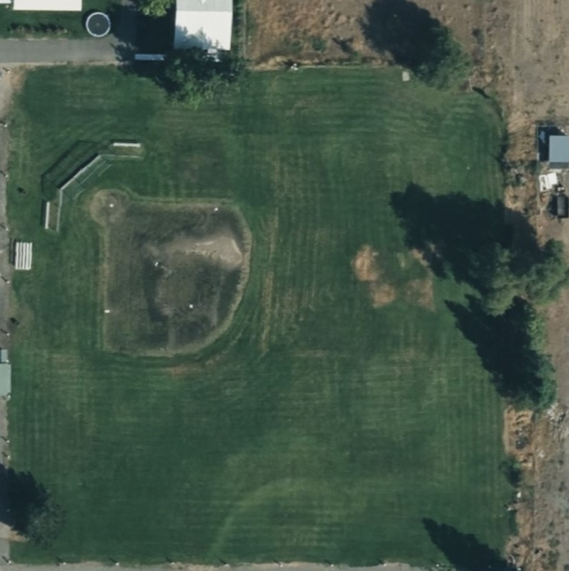
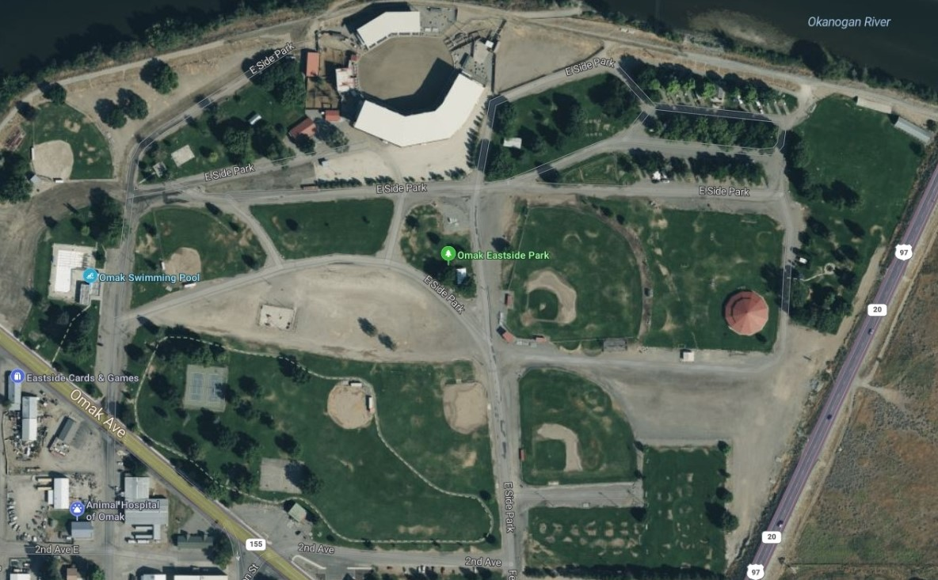
The ball fields take up a large majority of the Parks they are in. The cost of keeping up the Fields is a large part of the Parks budget.

Slide 28
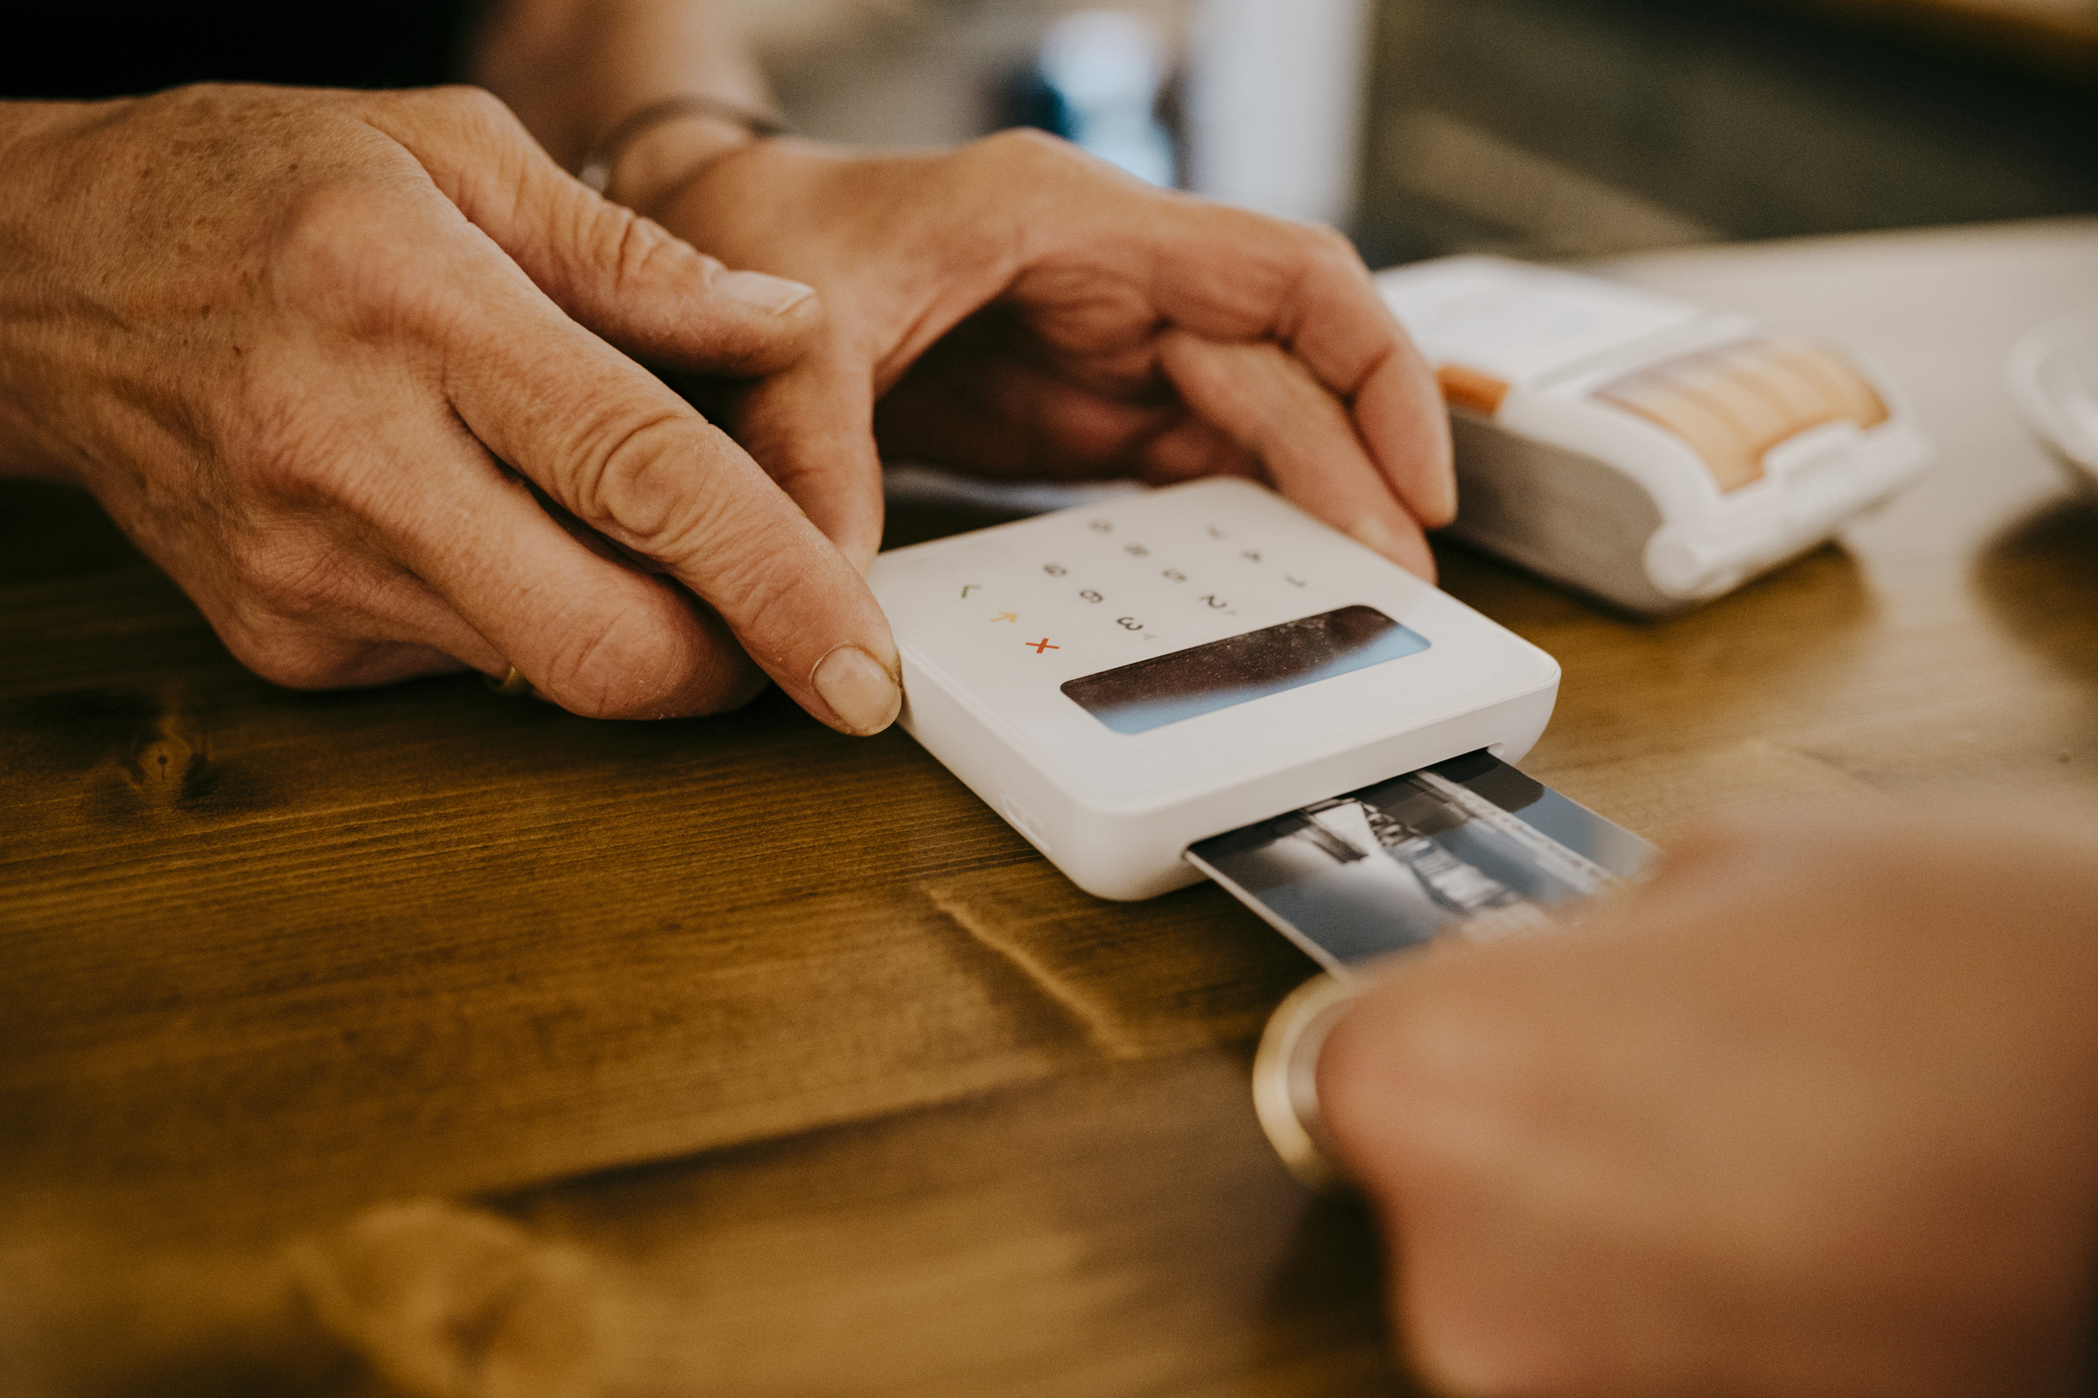
What they Charge

Slide 29
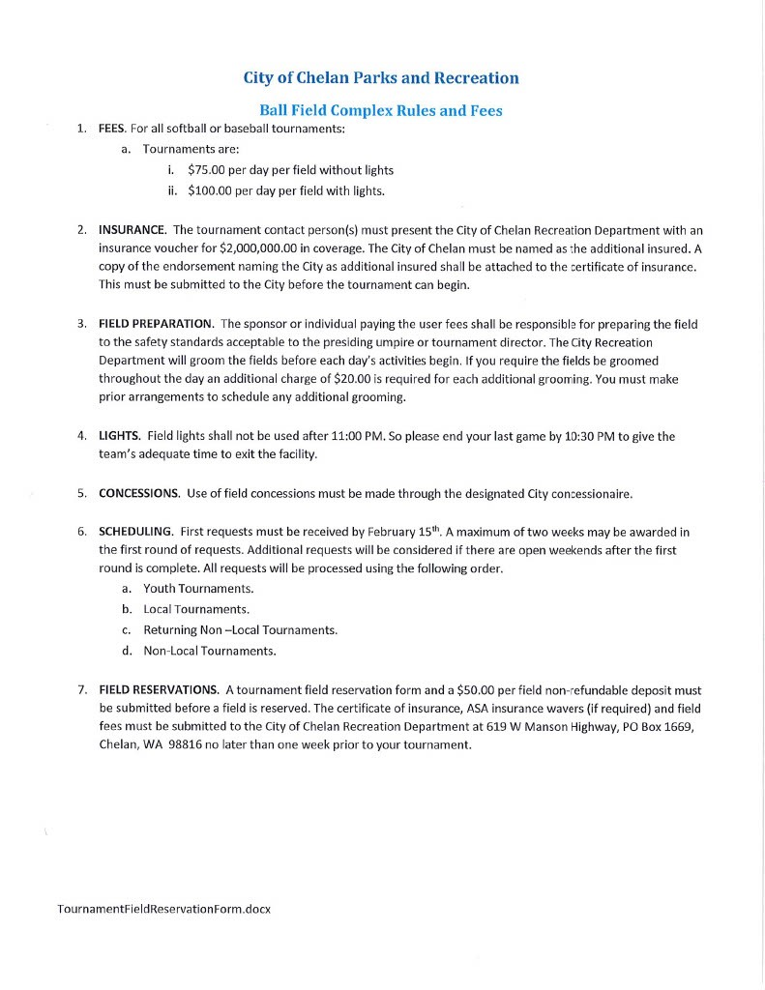
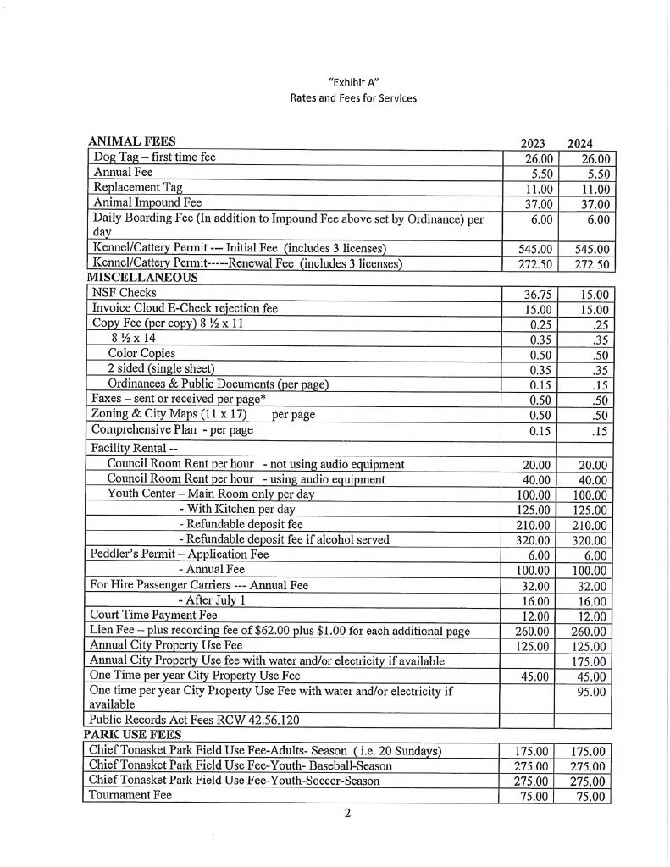
Chelan Fees
Tonasket Fees

Slide 30
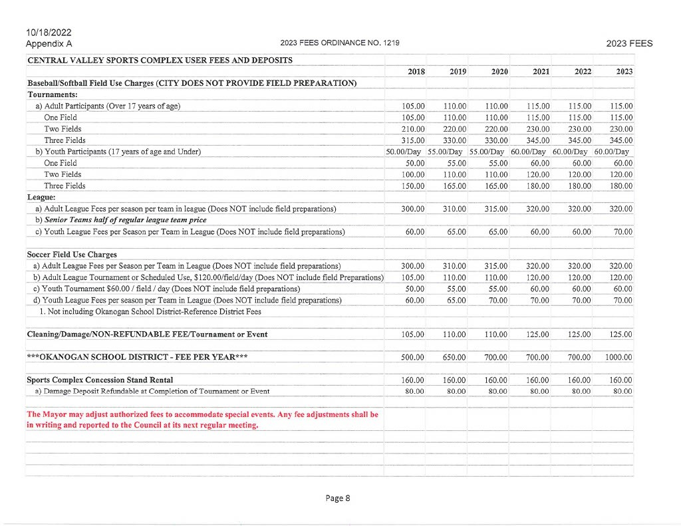
Okanogan Sports Complex

Slide 31
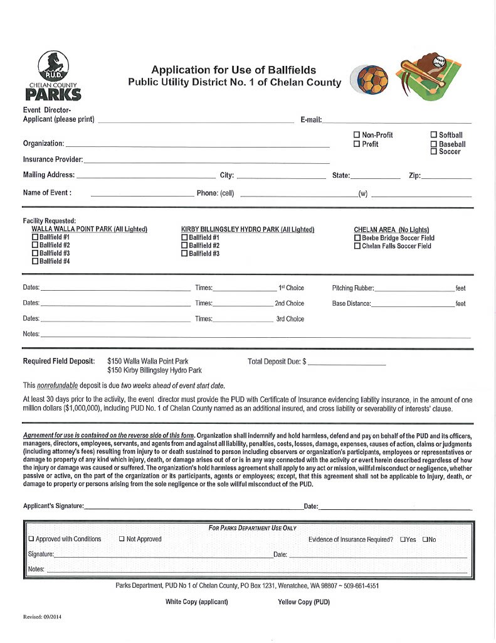
Chelan County Parks. In Wenatchee and East Wenatchee many of the ball fields are run by the PUD. The exception is Eastmont 4-Plex. Their pricing is not published.

Slide 32
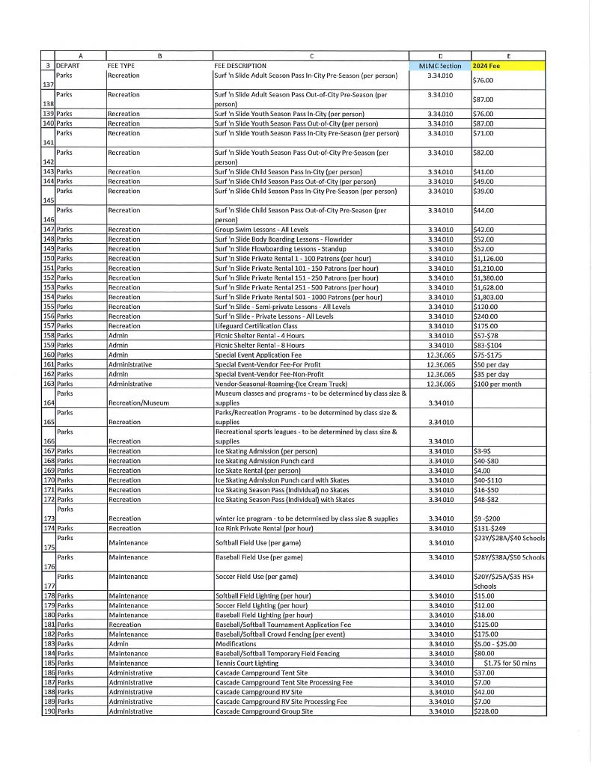
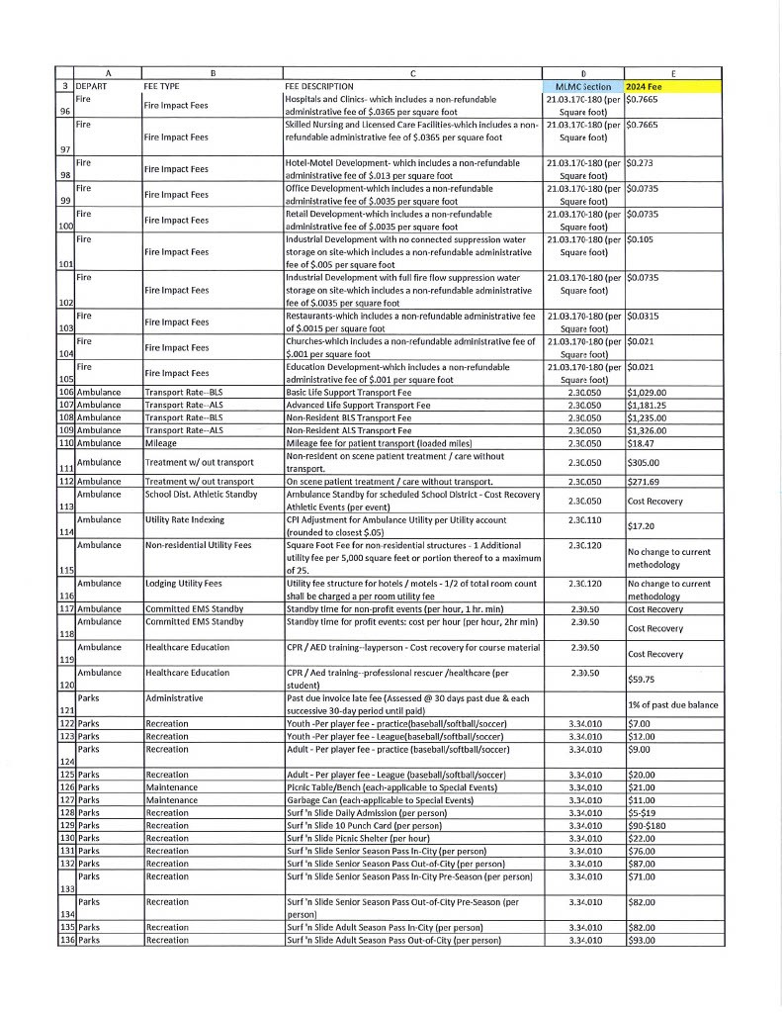
Moses Lake Field Fees

Slide 33
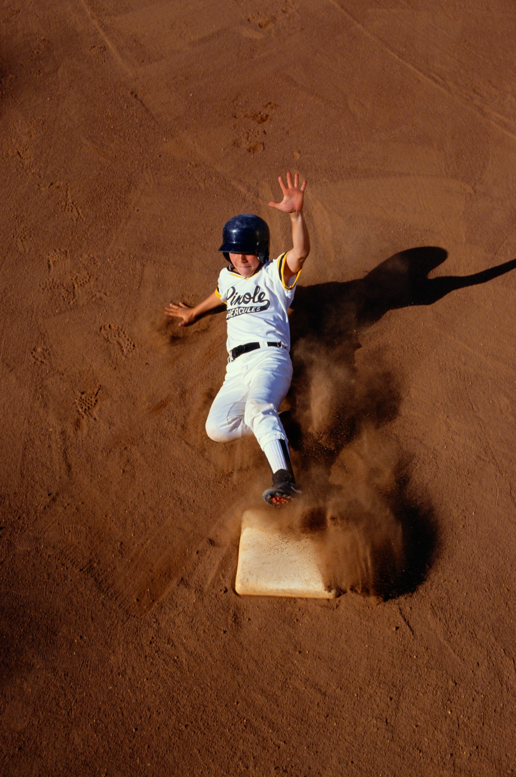
Proposed Fees

Slide 34
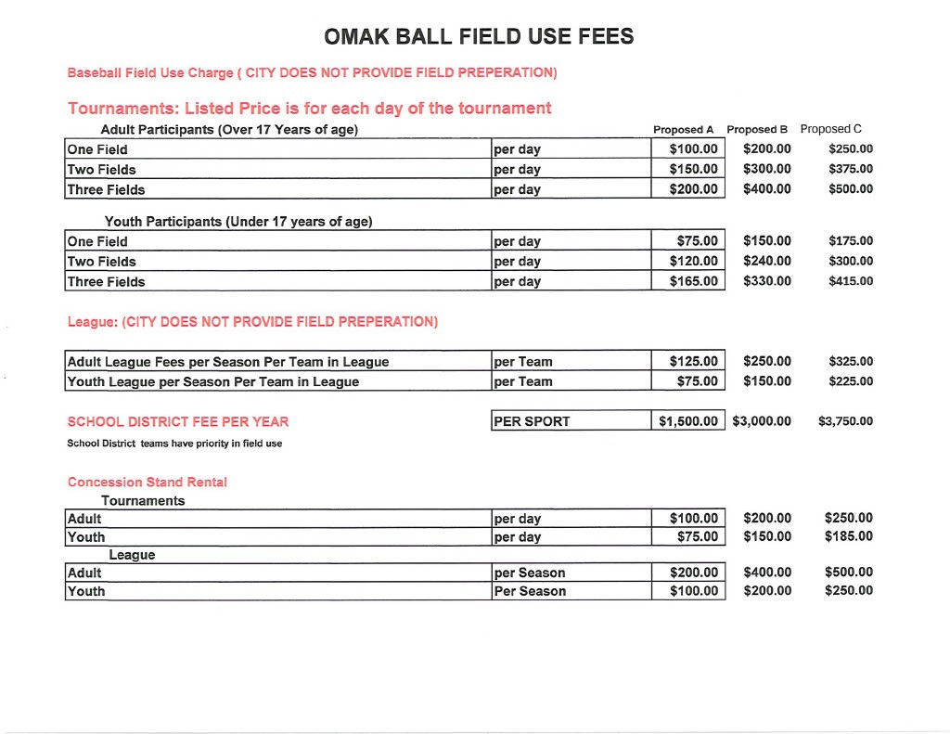
Proposed Fees
Baseball and Softball
We are proposing three different levels of fees to consider. We wanted to give options that would place us below average, average, and above average compared to other communities.
The fees for Leagues would be per team in the league and for the entire season.
Tournament fees would be per day fees and increase if you nee more than one field

Slide 35
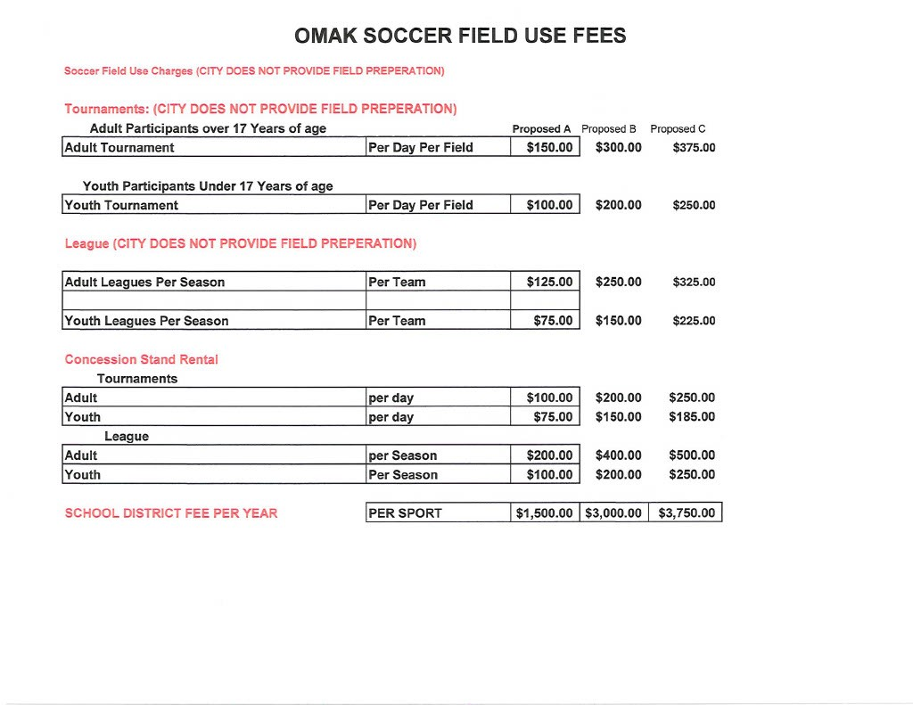
Proposed Fees
Soccer
Like Ball fields the fees for Leagues would be per team for the entire season.
Tournaments would be for a per day per field fee.

Slide 36
It’s really not that much money for the Leagues

Slide 37
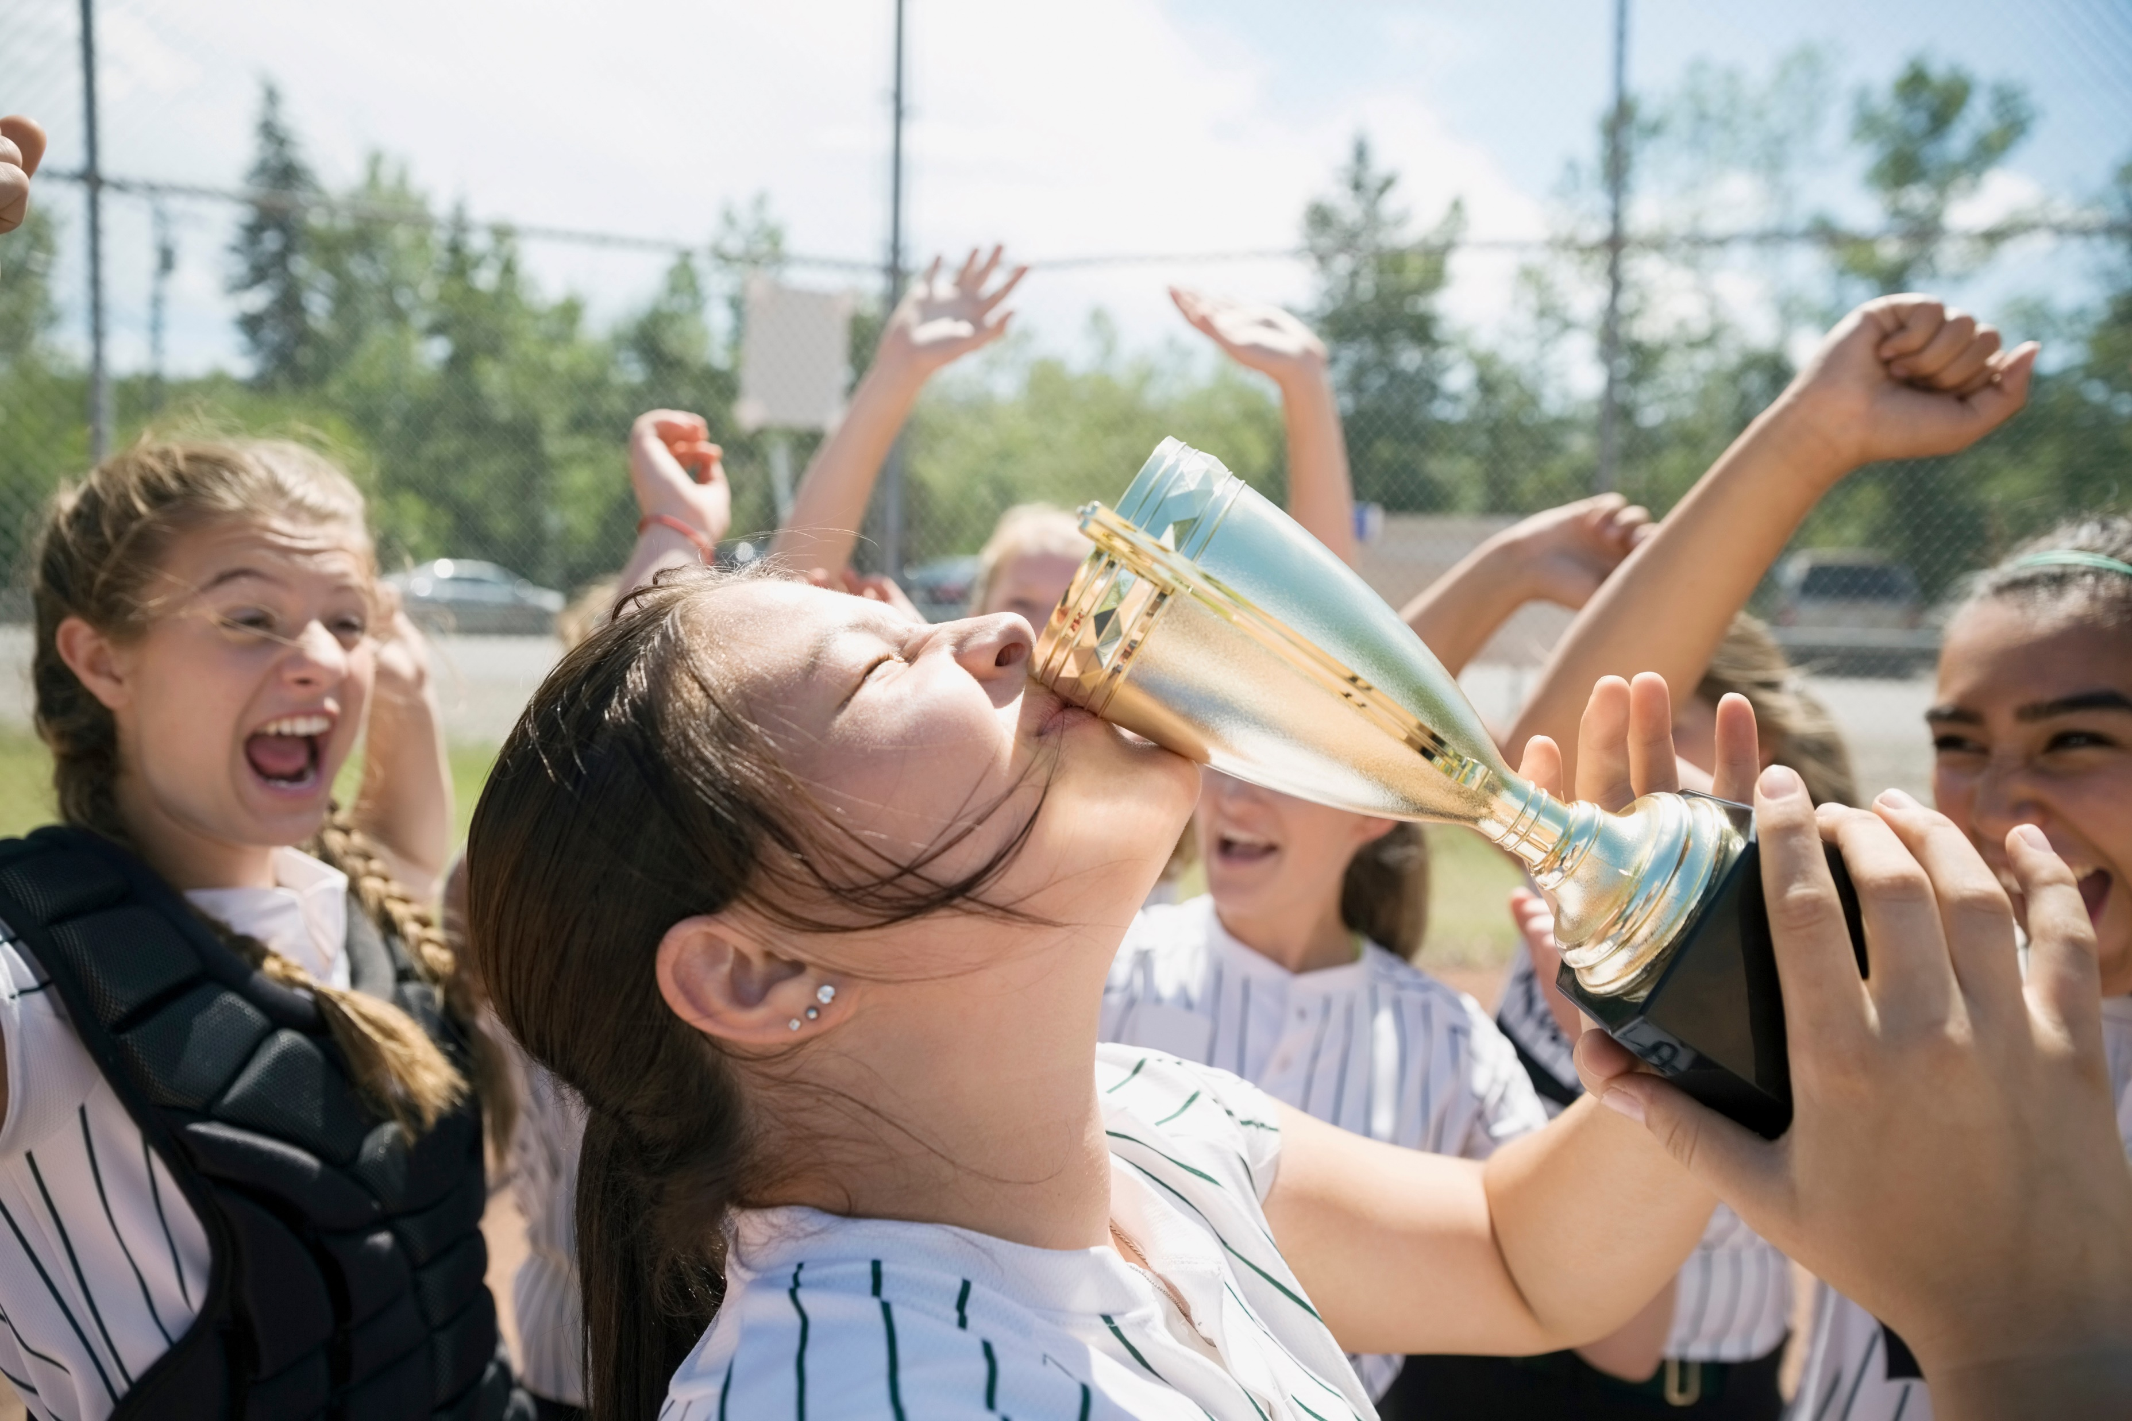
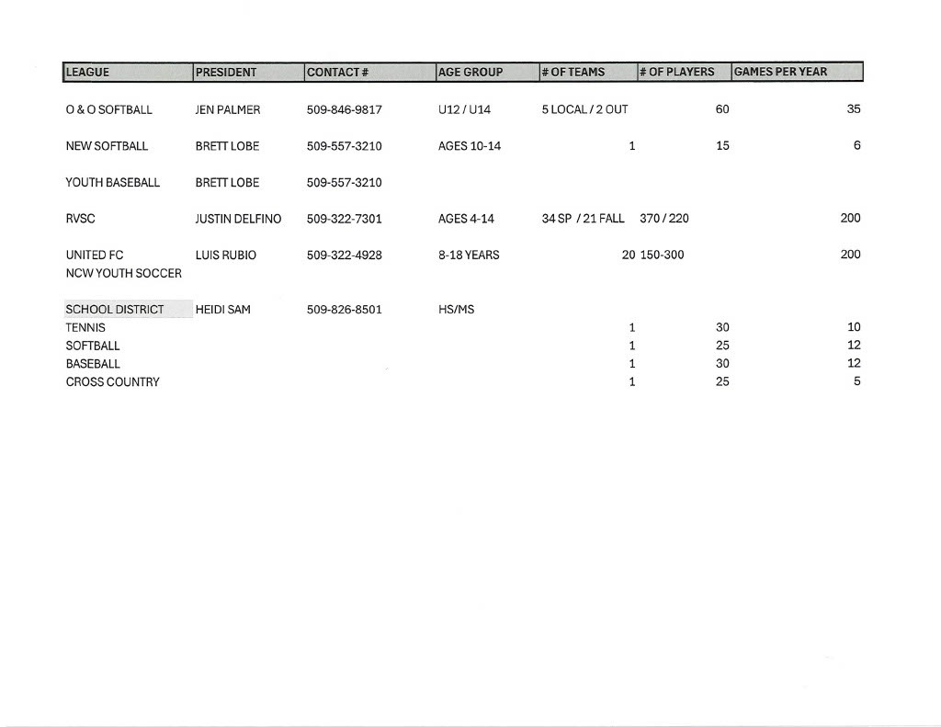
The Numbers
These numbers were submitted by the leagues reflecting how many kids they believe they will have this season

Slide 38
If a League like River Valley Soccer in the Spring has 34 teams and a total of 370 Players:
34 teams x 75.00 per team = $2550.00 per season
$2550.00 / 370 Kids = $6.89 per player!
The overall cost per player is not a huge price!
EXP 2
O&O Softball has 5 Local Teams with a total of 60 Players
5 teams x $75.00 per team = $375.00 per Season
$375.00 / 60 Players = $6.25 per player!
The average cost per player doesn’t change by league size.

Slide 39
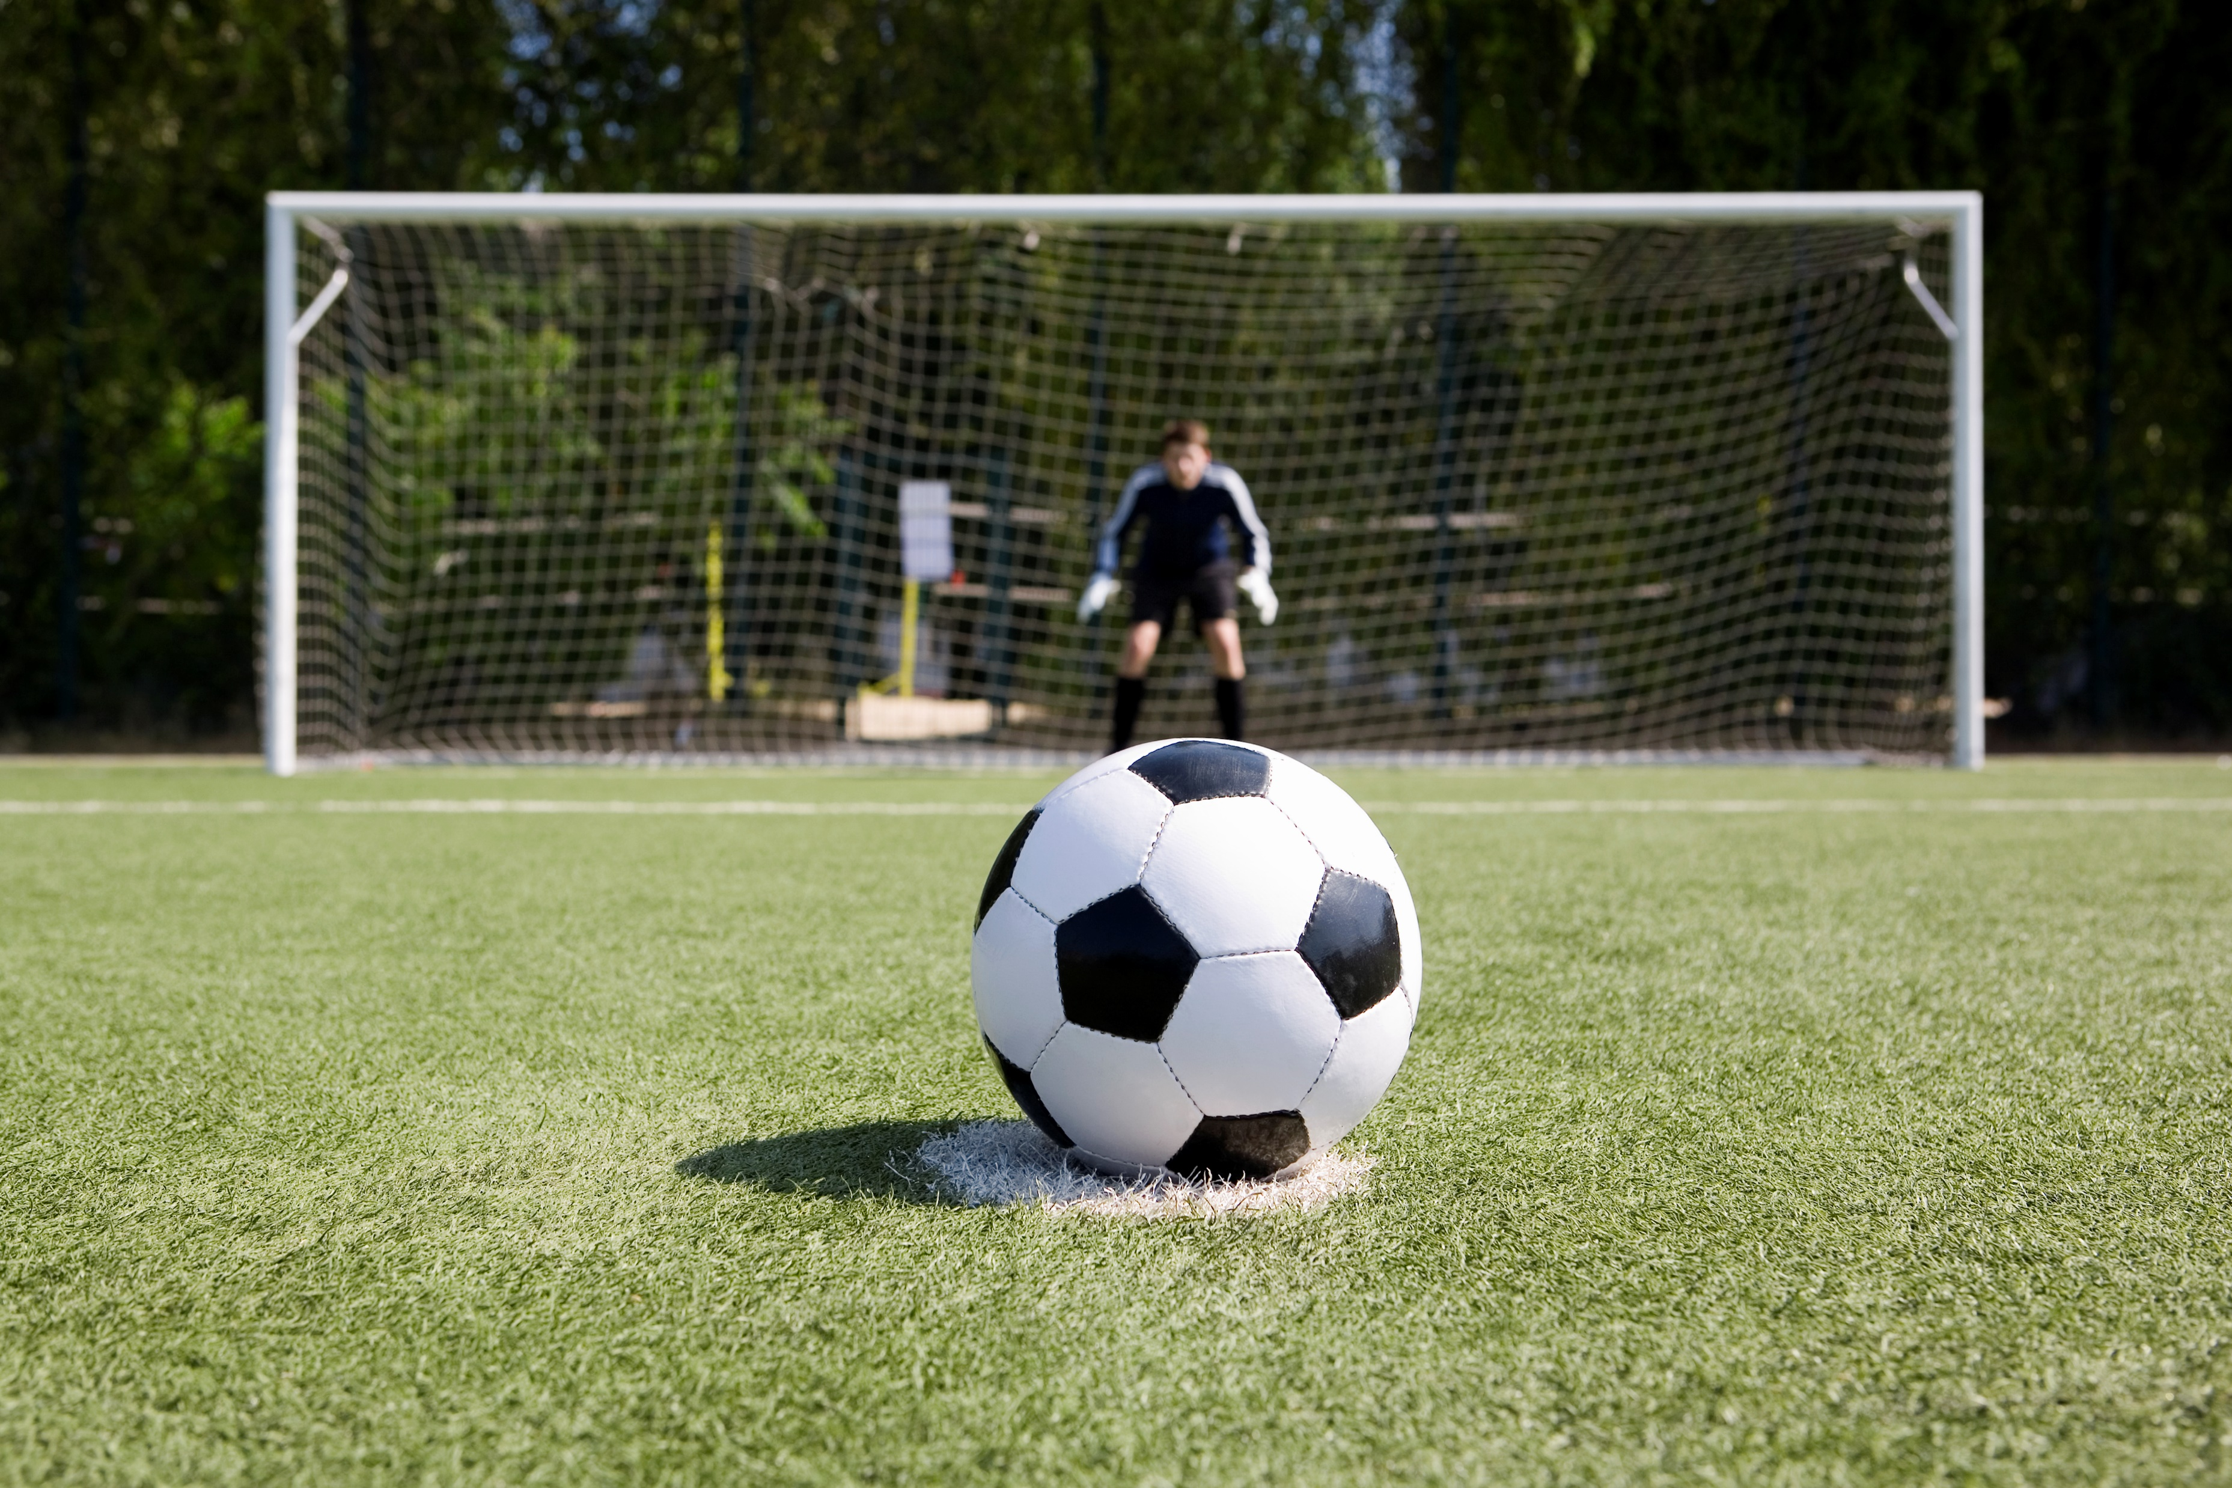
What can the fees do for our parks?

Slide 40
Total Number of teams- 81 x $75.00 = $6075.00
School District 4 Teams- 4 x $1500.00 = $6000.00
Total - $12075.00
How much will the fees bring to the Parks

Slide 41
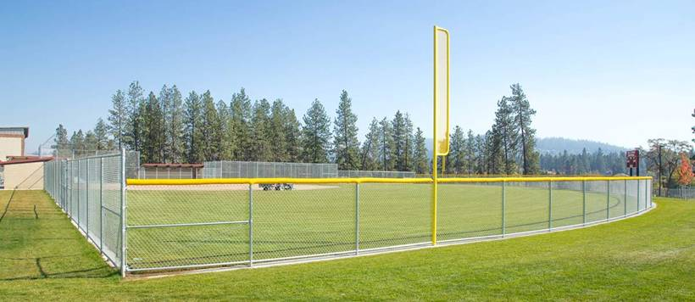
A percentage of the fees collected can be put back into the fields to make them better. Upgrades like fencing, Infield dirt, Warning tracks, Artificial surface goalie boxes.

Slide 42
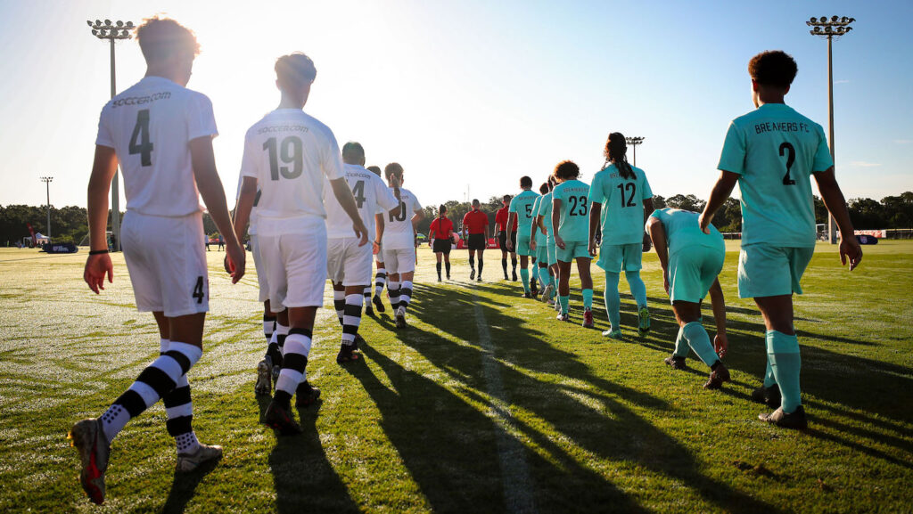
We don’t currently have leagues or organizations that want to hold tournaments on our fields. If we invest in them and make them competitive with other areas that can change, and we could bring in even more in fees through tournaments. That can help the Parks and the City. The direct impact can include local spending at hotels, restaurants, attractions, and retailers.

Slide 43
If We Build It
(or just make it better)
They Will Come!

