Slide 1
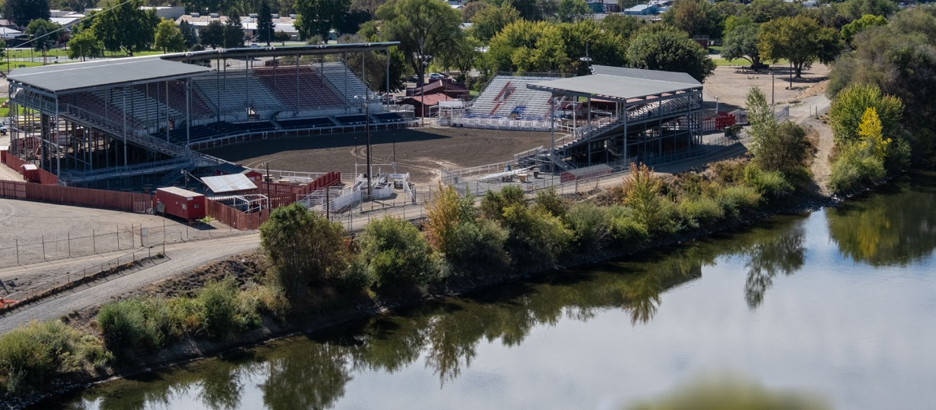
City of Omak Shoreline Master Program Periodic Review Update
Photo by Michelle Miller

Slide 2
Topics
Introductions
Goals
Shoreline Management Act (SMA)
Shoreline Master Program (SMP)
Updating the SMP
Scoping
Public Participation
Schedule
Discussion
Photo by Michelle Miller

Slide 3
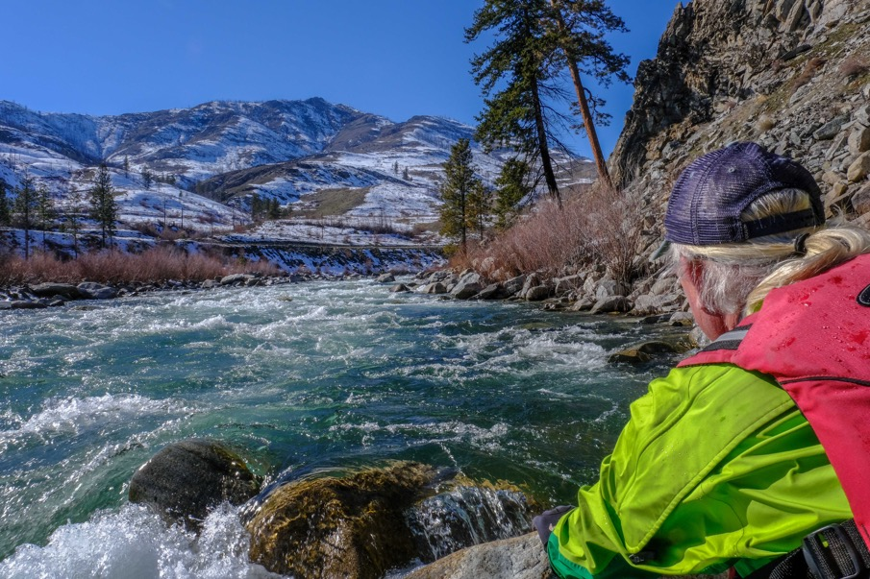
Introductions
Kurt Danison, Planner, Highlands Associates
Photo by Michelle Miller

Slide 4
Presentation goals
Provide overview of the Shoreline Management Act and the periodic review update process
Discuss why public participation is necessary and important
Answer your questions
Photo by Michelle Miller

Slide 5
Shoreline Management Act (SMA)
The SMA is a state law (RCW 90.58)
Provides a framework for managing, accessing, and protecting shorelines.
Goal: prevent the inherent harm from uncoordinated and piecemeal development of shorelines.
Reflects the strong interest of the community for recreation, protection of natural areas, aesthetics, and commerce on Washington’s shorelines and waterways.
Is a cooperative program between the City of Omak and the Department of Ecology (Ecology).
Photo by Michelle Miller

Slide 6
Where SMA Applies
The SMA applies to:
Marine waters
Rivers and streams over 20 cubic feet per second mean annual flow
Lakes and reservoirs 20 acres and greater
Adjacent areas, typically within 200 feet of the Ordinary High Water Mark (OHWM)
Wetlands
Notes:
https://apps.ecology.wa.gov/coastalatlas/tools/Map.aspx

Slide 7
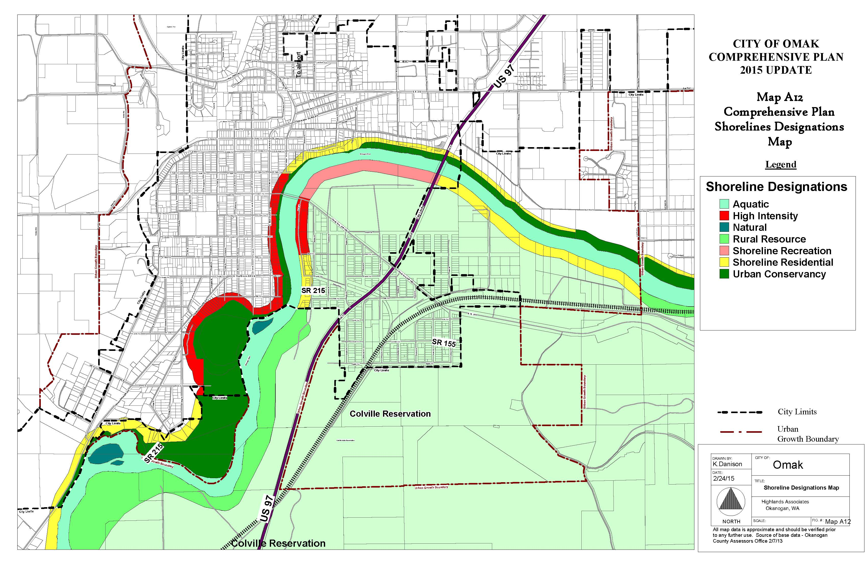

Slide 8
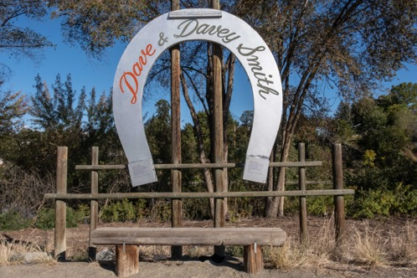
Shoreline Master Program (SMP)
SMP is:
A planning and regulatory document
Prepared by local government
Subject to laws (RCW 90.58)
Subject to rules (WAC 173-26)
SMP contains local policies and regulations
City of Omak adopted Okanogan County SMP.
Photos by Michelle Miller

Slide 9
SMP (CONTINUED)
City of Omak
Initiates and plans SMP
Administers and enforces the SMP
Ecology
Provides grant funds for SMP updates
Must approve SMP
Reviews and approves conditional use permits and variances

Slide 10
Preferred Uses OF SHORELINES
The preferred uses of the shoreline, in preference order are:
Protect and restore
Water dependent and water related uses
Mixed use developments
Water related and water enjoyment uses
Single family residential uses

Slide 11
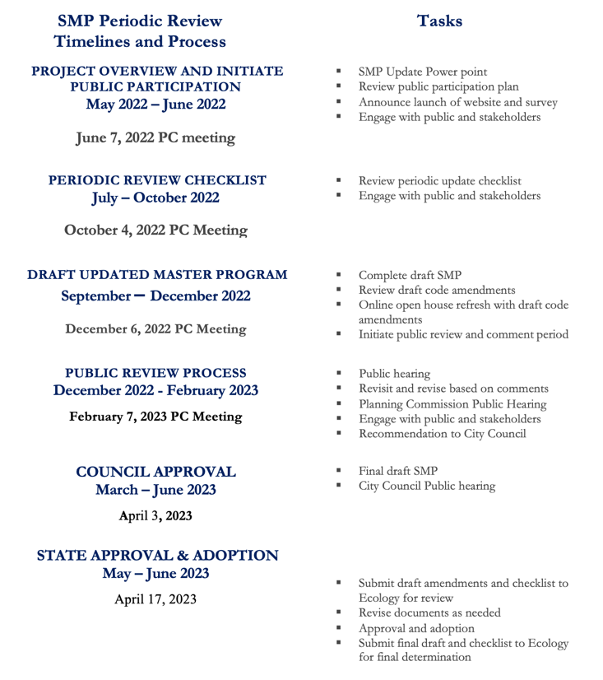
Periodic Review UPDATE
A periodic review is generally a multi year planning process with 6 phases (P1-P6):
P1 - Public participation plan
P2 - Inventory
P3 - Designations, policy & regulations, cumulative impacts
P4 - Restoration plan
P5 - Local approval
P6 - State approval

Slide 12
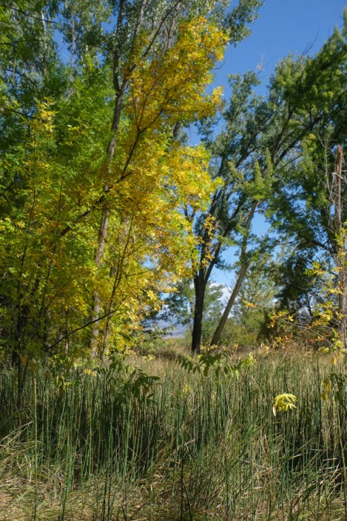
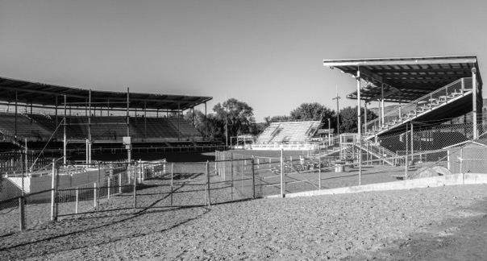
Scoping
Consistency review of existing SMP
What needs to be updated?
Shoreline issues?
Flooding
Public access
Habitat loss
Vegetation
Restoration needed?
Photos by Michelle Miller

Slide 13
Public Participation Plan
Website
Survey
Community visioning
One of the policies in the SMA is to promote public access and enjoyment opportunities.
Allows community to realize vision for the shorelines
Allows for strategic development
Preserves shorelines for future generations
Maintains and encourages public access

Slide 14
Survey - https://www.surveymonkey.com/r/OmakSMP
Please complete the 13 question survey!

Slide 15
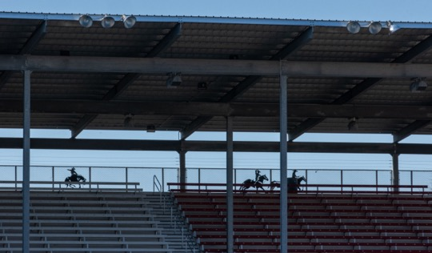
Discussion
Questions
Comments
Suggestions
Photo by Michelle Miller

